Slide 1

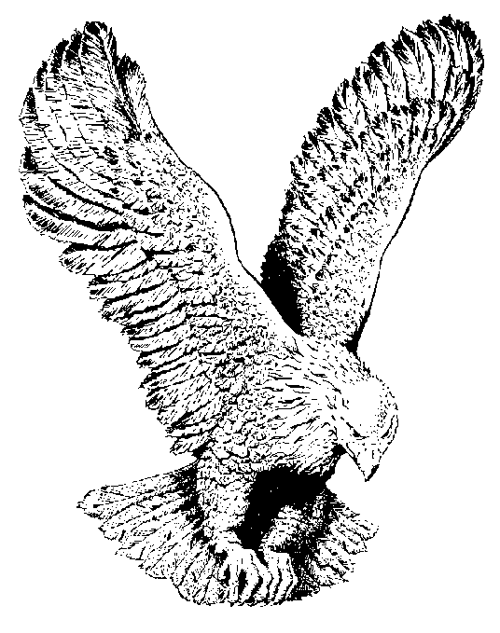
934 ANYBODY HERE KNOWS
Anybody here knows about the....
Love of Jesus, I do, yes I do
Grace of Jesus, we do, yes we do
Power of Jesus, we all do, yes we do
Love of sweet Jesus (2x)

